Slide 1
Admin Manual
HTA Application

Slide 2
Table Of Contents
Main Page Navigation Page 3
Main Page Navigation to Process Viewer Page 4
Attachments for Forms, ETC Page 5
Adding Records in Process Viewer Page 6
Viewing/Editing Previously Added Records Page 7
Editing Records Page 8
Searching the Records(AND / OR) Information Page 9
Searching instructions and Autocomplete Page 10
Export to Excel Page 11

Slide 3
Admin Page Options
Add Process
Edit Process
Delete Process
Toggle Visibility of a Process
Create A Table
Change Name of a Table
Change Column Names
Add Columns
Delete Table(Hidden Option)
Add/Remove Autofill from a Table
Discontinue A Table
Link Table to Process
Add Attachment
Add Administrator / Enable Delete
All these options open up there own form. Where the user can complete the actions that they want to do.

Slide 4
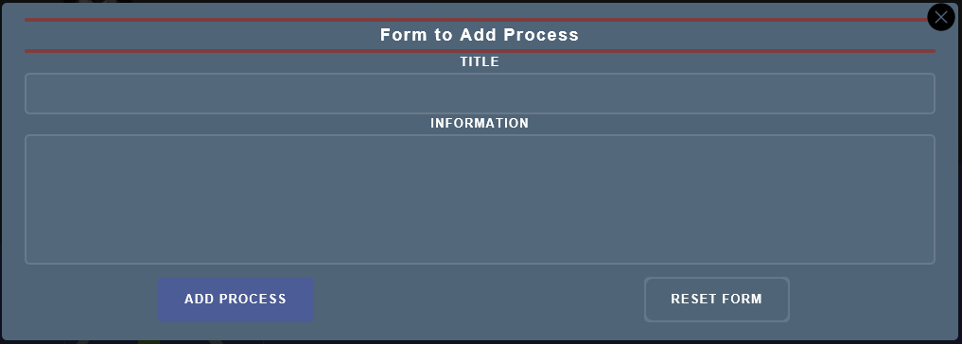
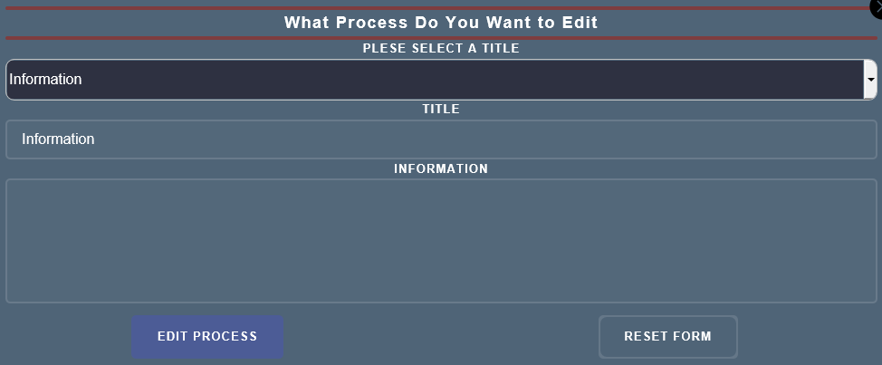
Add Process
Edit Process
Adding is as easy as filling out a simple form.
While Editing you just select an existing process that you want to edit from the drop down then you can change the name or information to your hearts content.

Slide 5
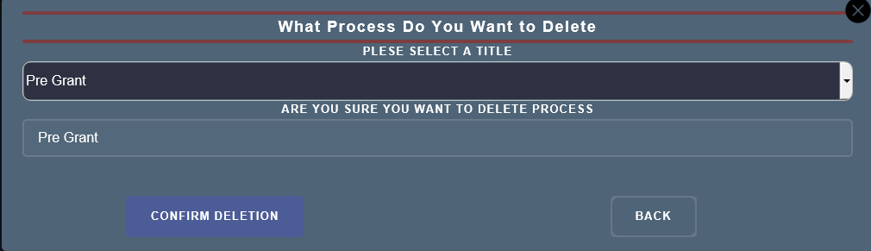
Delete & Hide Process
The Process for Deleting a Process and Hiding a Process is practically the same the only difference that instead of the button to submit saying Confirm Deletion it says confirm hide.
First select the title that you want to delete or hide.
Then Click Confirm Delete or Confirm Hide Depending on what you want to do.

Slide 6
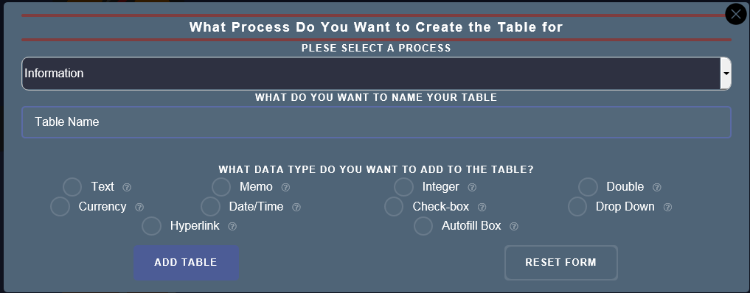
Create a Table
First select the process you want to create the table in.
Then Type in the what you want to name the Table.
Finally you start selecting what datatypes you want your table to consist of and in the order you want to enter in the data.

